Slide 1
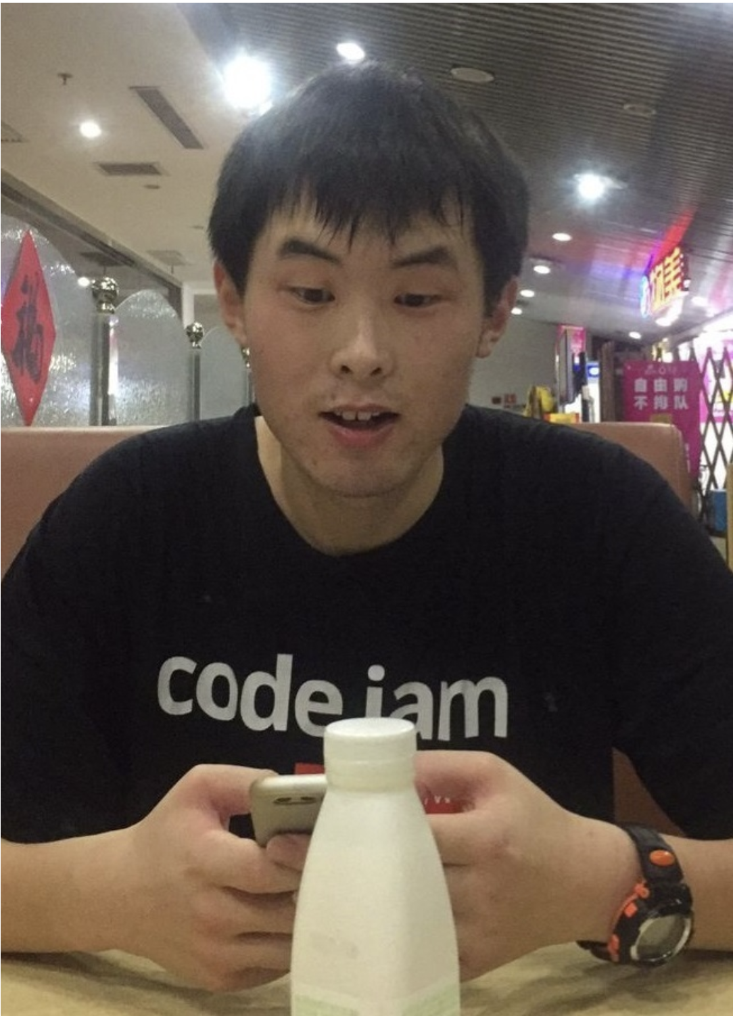

An Improved Sketching Bound for Edit Distance
Kewen Wu (UC Berkeley)
Joint with Ce Jin (MIT) and Jelani Nelson (UC Berkeley)

Slide 2
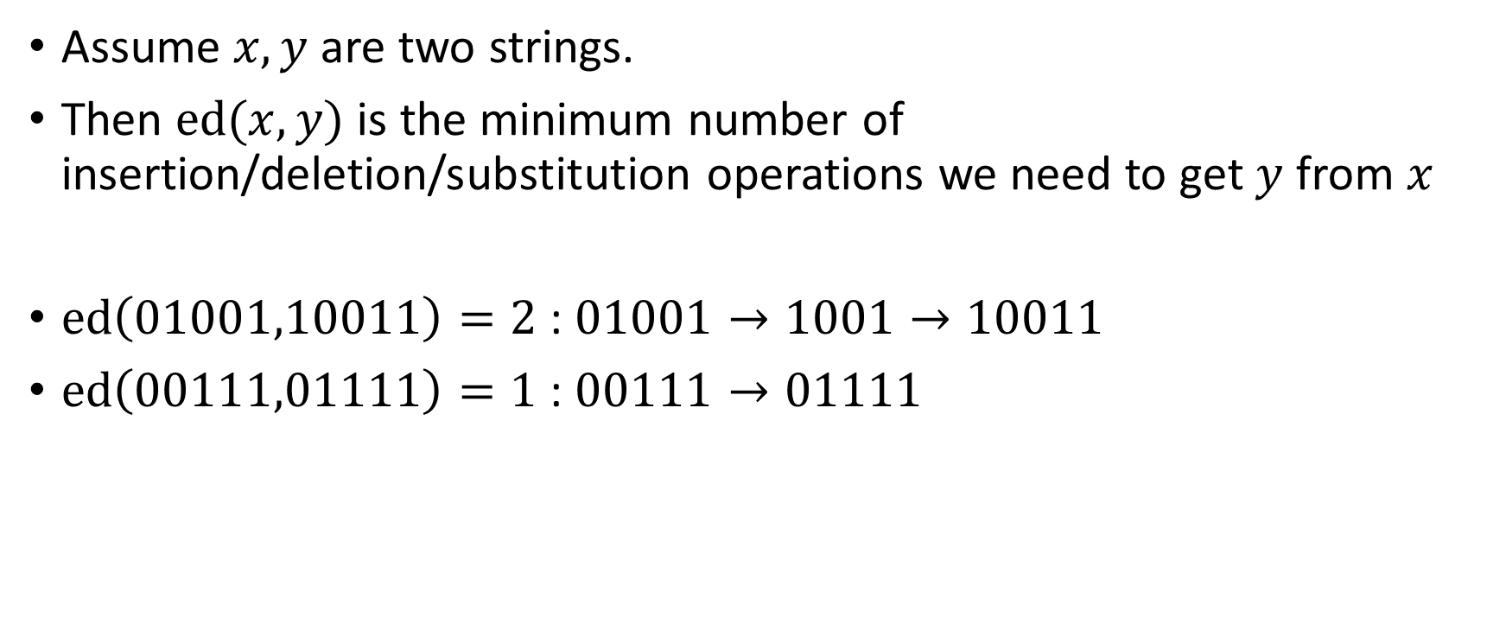
Edit distance
Assume $x,y$ are two strings.
Then $ed(x,y)$ is the minimum number of insertion/deletion/substitution operations we need to get $y$ from $x$
$ed\left(01001,10011\right)=2$ : $01001→1001→10011$
$ed\left(00111,01111\right)=1$ : $00111→01111$

Slide 3







File 6
File 1
Sketch 6
Server
File 5
Sketch 1
File 2
Sketch 5
Sketch 2
Sketch 4
Sketch 3
File 3
File 4

Slide 4
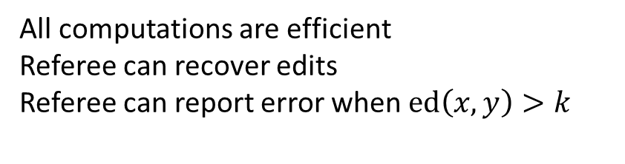
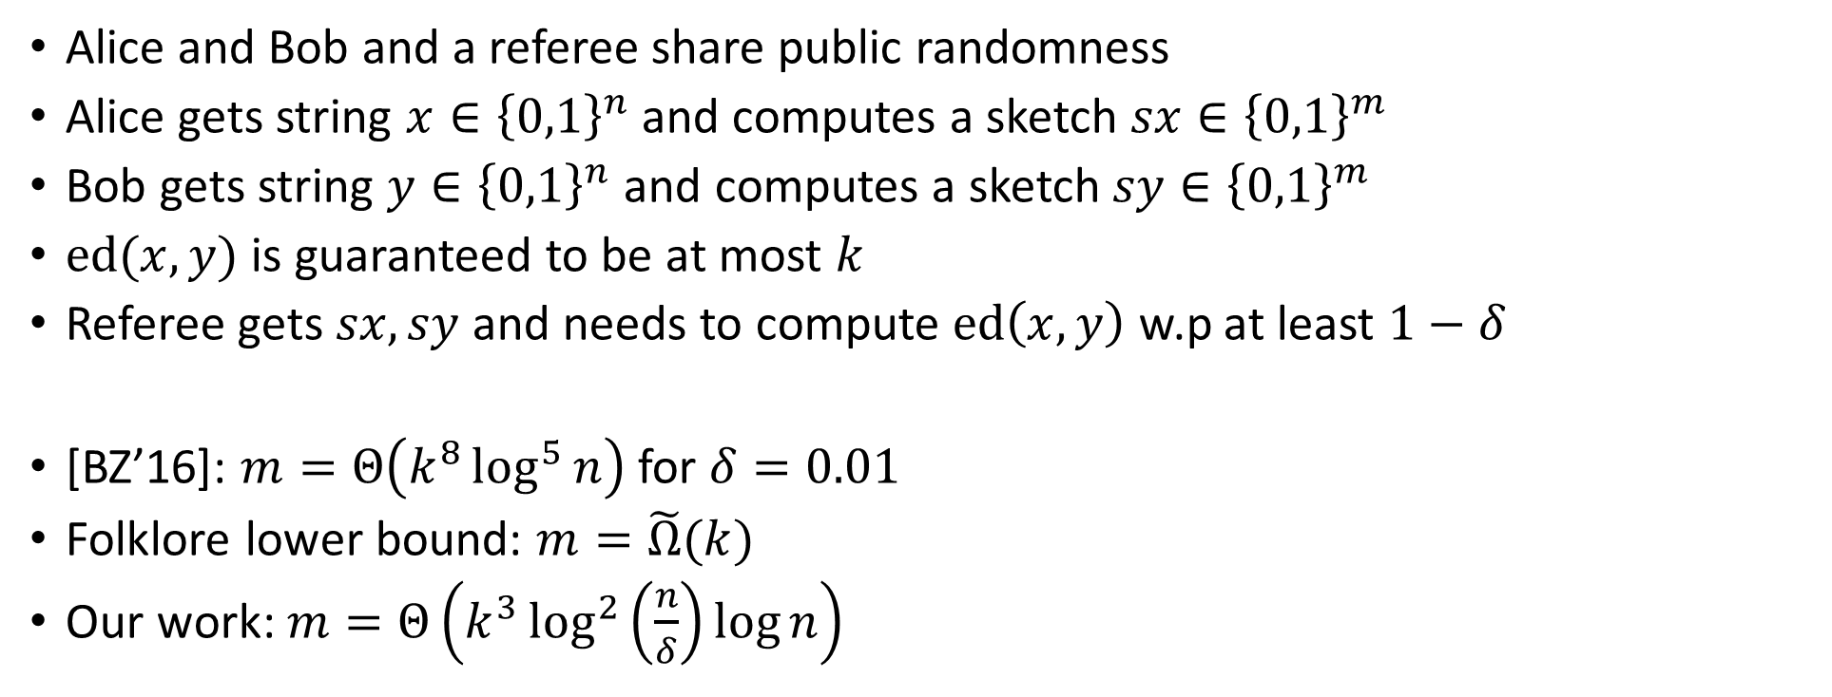
Problem setting
Alice and Bob and a referee share public randomness
Alice gets string $x∈{\left\{0,1\right\}}^{n}$ and computes a sketch $sx∈{\left\{0,1\right\}}^{m}$
Bob gets string $y∈{\left\{0,1\right\}}^{n}$ and computes a sketch $sy∈{\left\{0,1\right\}}^{m}$
$ed(x,y)$ is guaranteed to be at most $k$
Referee gets $sx,sy$ and needs to compute $ed\left(x,y\right)$ w.p at least $1−δ$
[BZ’16]: $m=Θ\left(k^{8}\log^{5}{n}\right)$ for $δ=0.01$
Folklore lower bound: $m=\tilde{Ω}(k)$
Our work: $m=Θ\left(k^{3}\log^{2}\left(\frac{n}{δ}\right)\log{n}\right)$
All computations are efficient
Referee can recover edits
Referee can report error when $ed\left(x,y\right)>k$

Slide 5
Optimal matching
The edit distance can be visualized by a matching
Red/grey singletons are deletions/insertions
Blue edges are substitutions
Black edges are unchanged characters
0000101010001111
1000010100011110
Let $f\left[i,j\right]≔ed(x\left[1..i\right],y\left[1..j\right])$
$$f\left[i,j\right]=\left\{\begin{aligned}1+\min\left\{f\left[i−1,j\right],f\left[i,j−1\right],f\left[i−1,j−1\right]\right\}, x\left[i\right]≠y\left[j\right] \\ \min\left\{f\left[i−1,j\right]+1,f\left[i,j−1\right]+1,f\left[i−1,j−1\right]\right\}, x\left[i\right]=y[j]\end{aligned}\right.$$

Slide 6
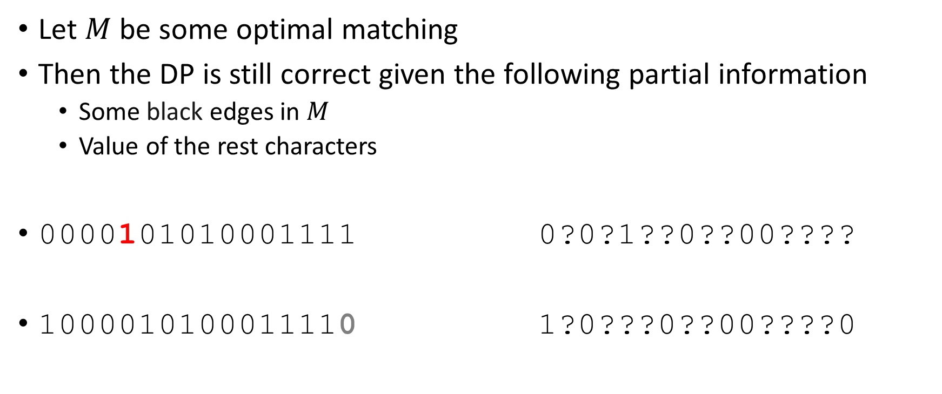
Back to our problem
Let $M$ be some optimal matching
Then the DP is still correct given the following partial information
Some black edges in $M$
Value of the rest characters
0000101010001111 0?0?1??0??00????
1000010100011110 1?0???0??00????0
Random walk techniques from [CGK’16]

Slide 7
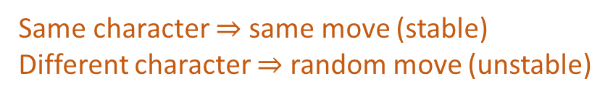
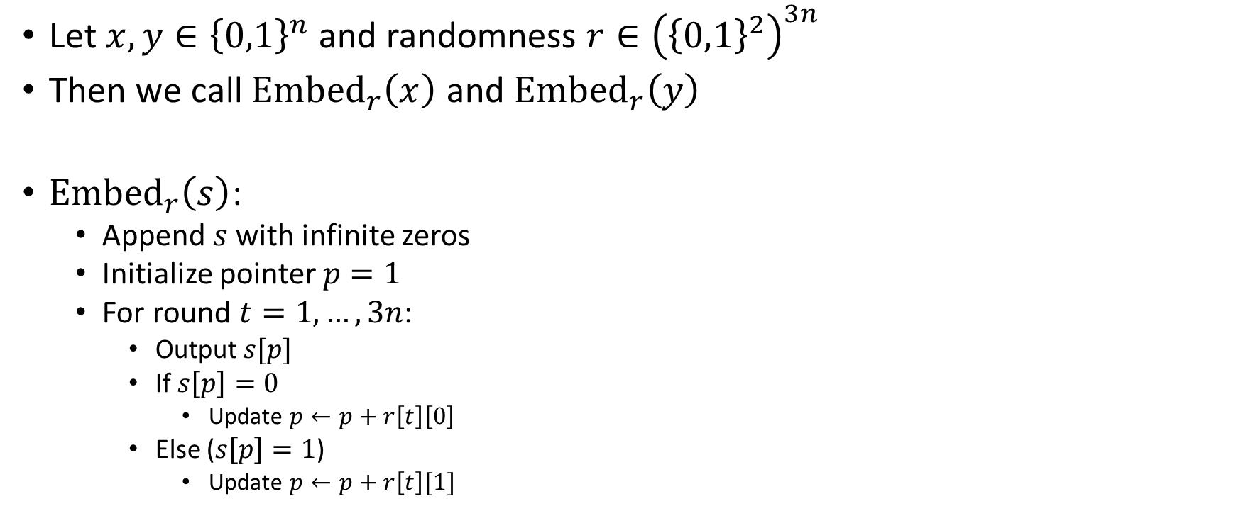
CGK random walk embedding
Let $x,y∈{\left\{0,1\right\}}^{n}$ and randomness $r∈{\left({\left\{0,1\right\}}^{2}\right)}^{3n}$
Then we call ${Embed}_{r}\left(x\right)$ and ${Embed}_{r}\left(y\right)$
${Embed}_{r}\left(s\right)$:
Append $s$ with infinite zeros
Initialize pointer $p=1$
For round $t=1,…,3n$:
Output $s[p]$
If $s\left[p\right]=0$
Update $p←p+r\left[t\right]\left[0\right]$
Else ($s\left[p\right]=1$)
Update $p←p+r\left[t\right][1]$
Same character $⇒$ same move (stable)
Different character $⇒$ random move (unstable)

Slide 8
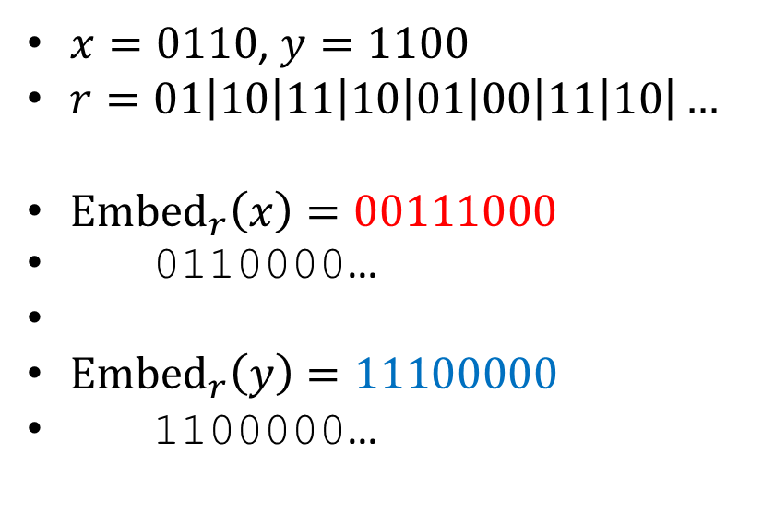
CGK random walk embedding
Output 0 1
01: 0 stay, 1 advance
Output 0 1
10: 0 advance, 1 stay
Output 1 1
11: 0,1 advance
Output 1 0
10: 0 advance, 1 stay
Output 1 0
01: 0 stay, 1 advance
Output 0 0
00: 0,1 stay
Output 0 0
11: 0,1 advance
Output 0 0
10: 0 advance, 1 stay
$x=0110$, $y=1100$
$r=01\left|10\right|11\left|10\right|01\left|00\right|11\left|10\right|…$
$Embed_{r}\left(x\right)=\text{00111000}$
0110000…
${Embed}_{r}\left(y\right)=11100000$
1100000…

Slide 9
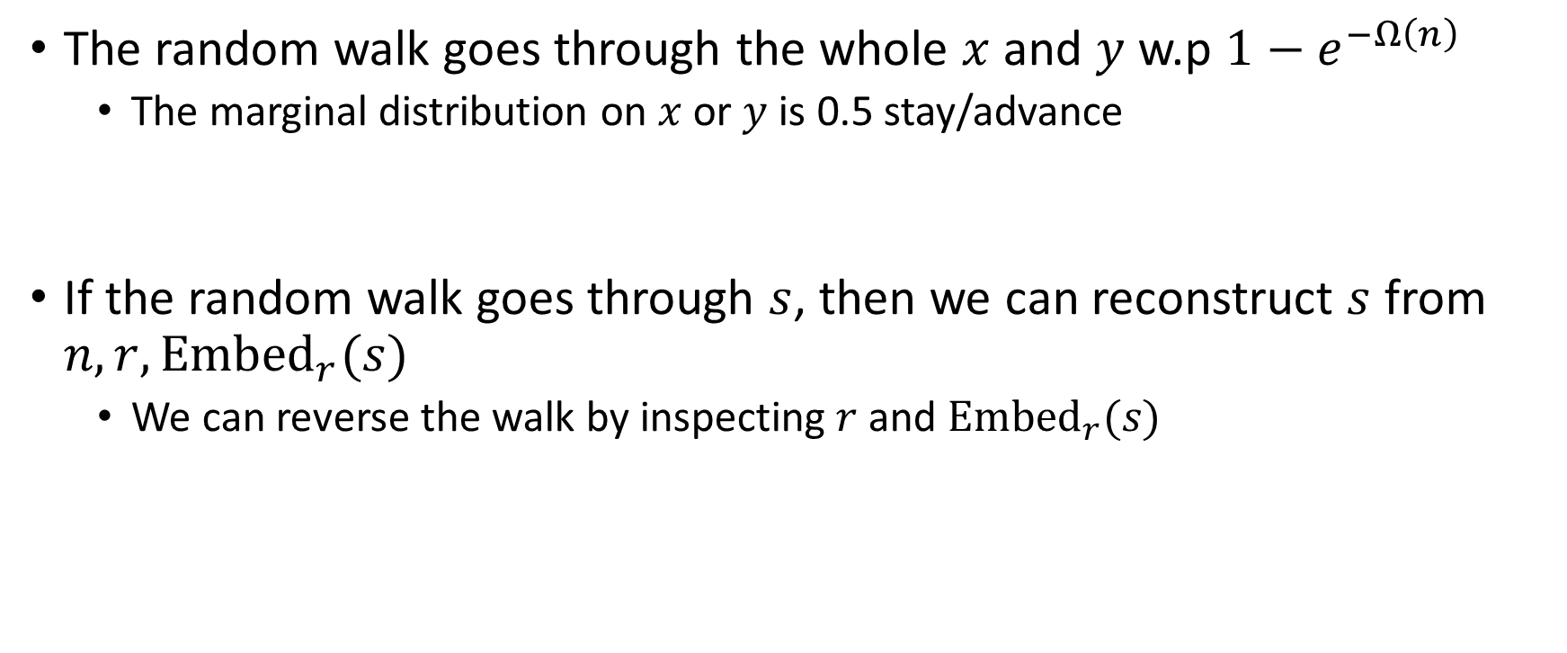
CGK random walk embedding
The random walk goes through the whole $x$ and $y$ w.p $1−e^{−Ω\left(n\right)}$
The marginal distribution on $x$ or $y$ is 0.5 stay/advance
If the random walk goes through $s$, then we can reconstruct $s$ from $n,r,{Embed}_{r}(s)$
We can reverse the walk by inspecting $r$ and ${Embed}_{r}(s)$

Slide 10
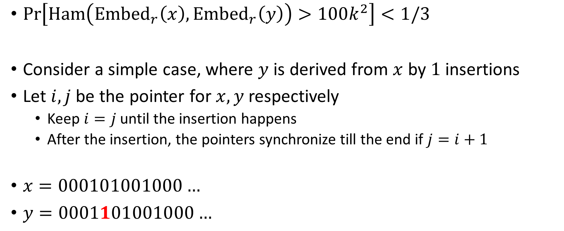
CGK random walk embedding
$Pr\left[Ham\left({Embed}_{r}\left(x\right),{Embed}_{r}\left(y\right)\right)>100k^{2}\right]<1/3$
Consider a simple case, where $y$ is derived from $x$ by $1$ insertions
Let $i,j$ be the pointer for $x,y$ respectively
Keep $i=j$ until the insertion happens
After the insertion, the pointers synchronize till the end if $j=i+1$
$x=000101001000…$
$y=0001101001000…$

Slide 11
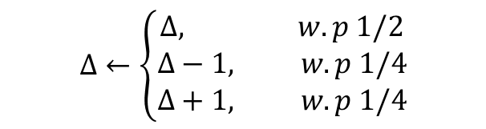
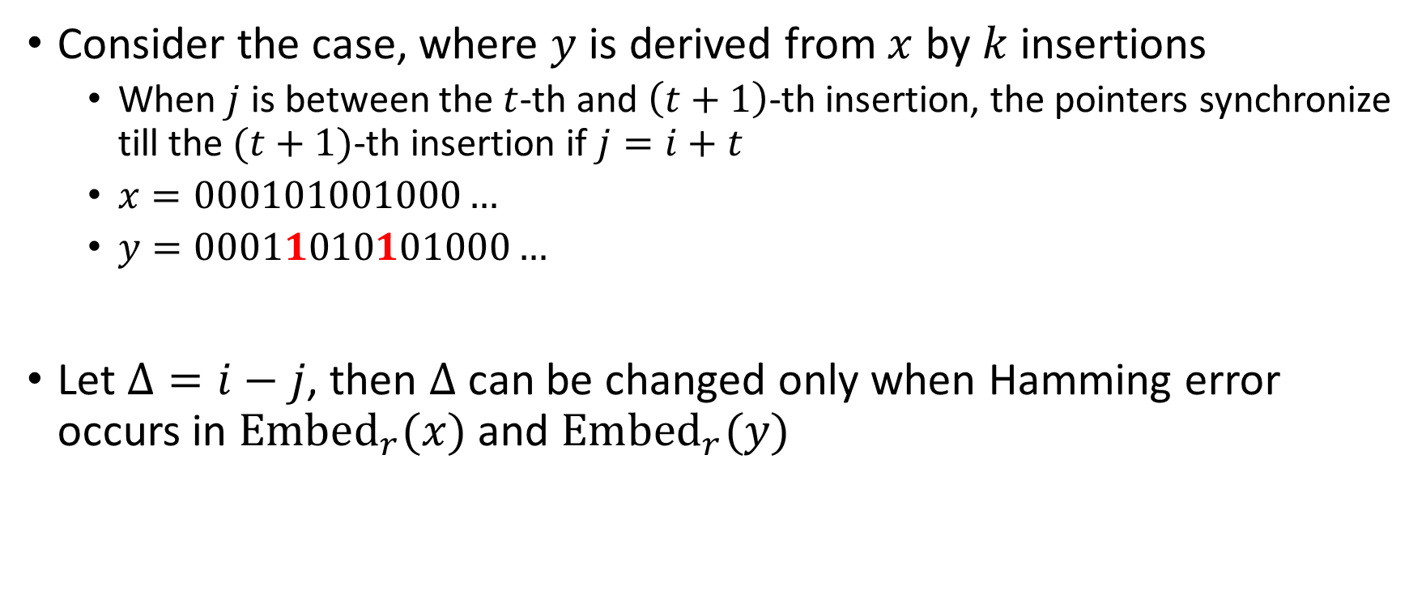
CGK random walk embedding
Consider the case, where $y$ is derived from $x$ by $k$ insertions
When $j$ is between the $t$-th and $\left(t+1\right)$-th insertion, the pointers synchronize till the $(t+1)$-th insertion if $j=i+t$
$x=000101001000…$
$y=00011010101000…$
Let $Δ=i−j$, then $Δ$ can be changed only when Hamming error occurs in ${Embed}_{r}(x)$ and ${Embed}_{r}(y)$
$$Δ←\left\{\begin{aligned}Δ, w.p 1/2 \\ Δ−1, w.p 1/4 \\ Δ+1, w.p 1/4\end{aligned}\right.$$
Progress step

Slide 12
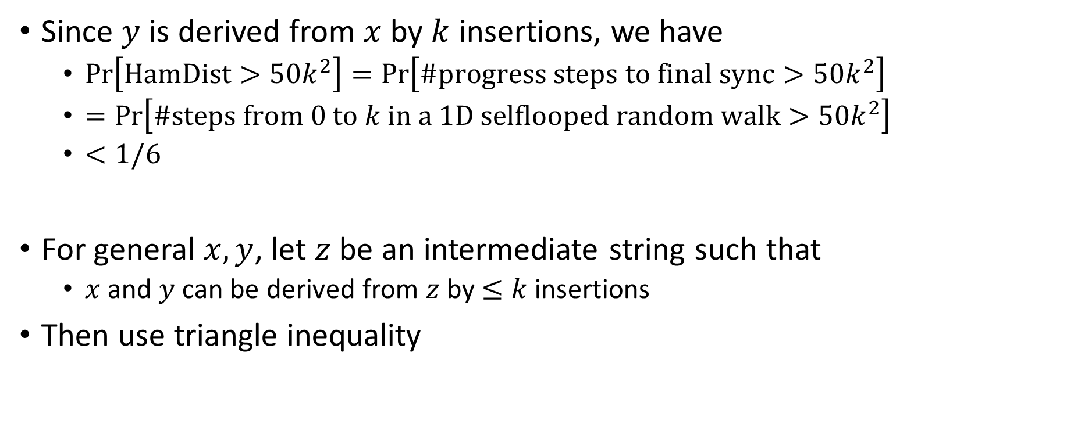
CGK random walk embedding
$$Pr\left[Ham\left({Embed}_{r}\left(x\right),{Embed}_{r}\left(y\right)\right)>100k^{2}\right]<1/3$$
Since $y$ is derived from $x$ by $k$ insertions, we have
$Pr\left[HamDist>50k^{2}\right]=Pr\left[\#progress steps to final sync>50k^{2}\right]$
$=Pr\left[\#steps from 0 to k in a 1D selflooped random walk>50k^{2}\right]$
$<1/6$
For general $x,y$, let $z$ be an intermediate string such that
$x$ and $y$ can be derived from $z$ by $≤k$ insertions
Then use triangle inequality

Slide 13
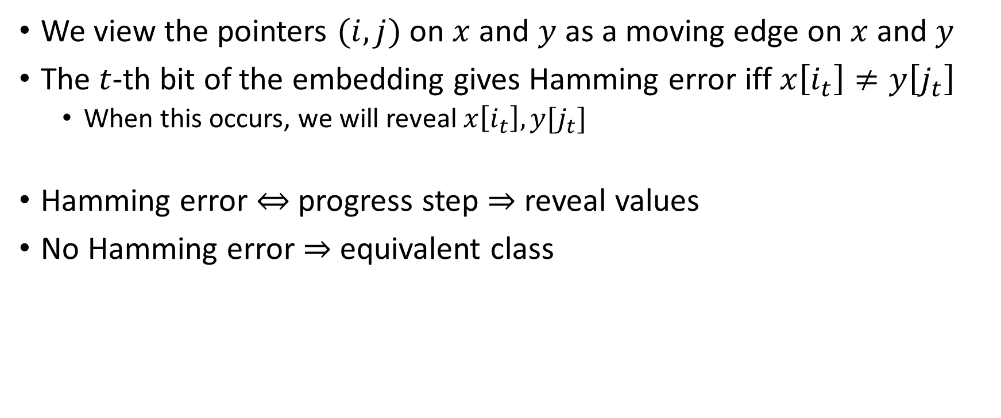
From CGK to DP
We view the pointers $(i,j)$ on $x$ and $y$ as a moving edge on $x$ and $y$
The $t$-th bit of the embedding gives Hamming error iff $x\left[i_{t}\right]≠y\left[j_{t}\right]$
When this occurs, we will reveal $x\left[i_{t}\right],y[j_{t}]$
Hamming error $⇔$ progress step $⇒$ reveal values
No Hamming error $⇒$ equivalent class

Slide 14
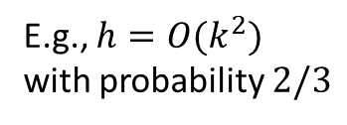
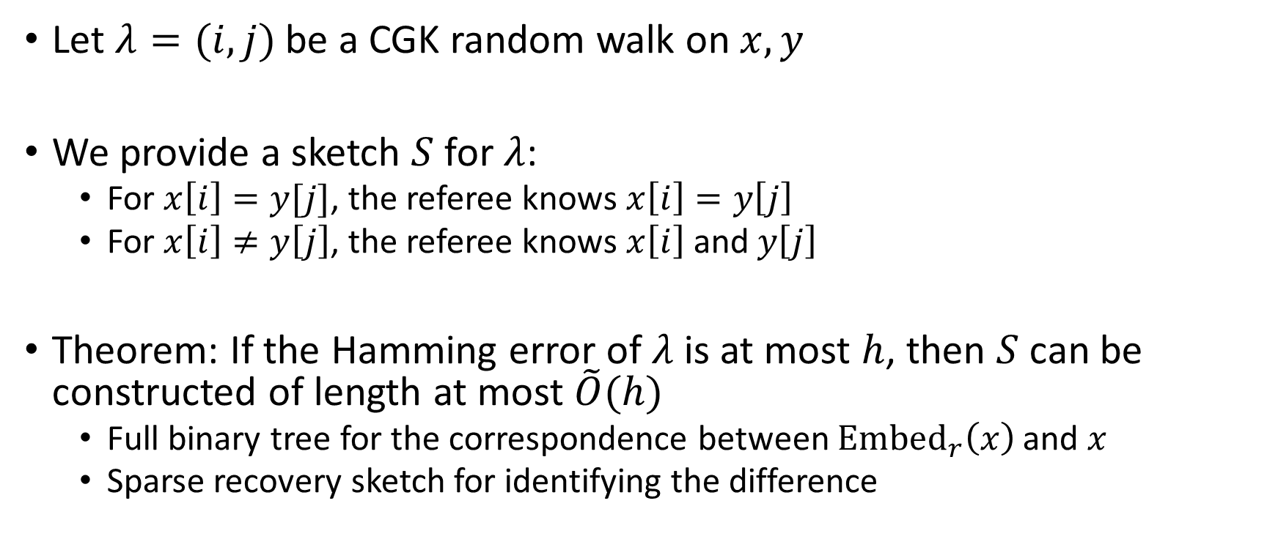
General framework
Let $λ=(i,j)$be a CGK random walk on $x,y$
We provide a sketch $S$ for $λ$:
For $x\left[i\right]=y[j]$, the referee knows $x\left[i\right]=y\left[j\right]$
For $x\left[i\right]≠y\left[j\right]$, the referee knows $x\left[i\right]$ and $y\left[j\right]$
Theorem: If the Hamming error of $λ$ is at most $h$, then $S$ can be constructed of length at most $\tilde{O}(h)$
Full binary tree for the correspondence between $Embed_{r}\left(x\right)$ and $x$
Sparse recovery sketch for identifying the difference
E.g., $h=O(k^{2})$ with probability $2/3$

Slide 15
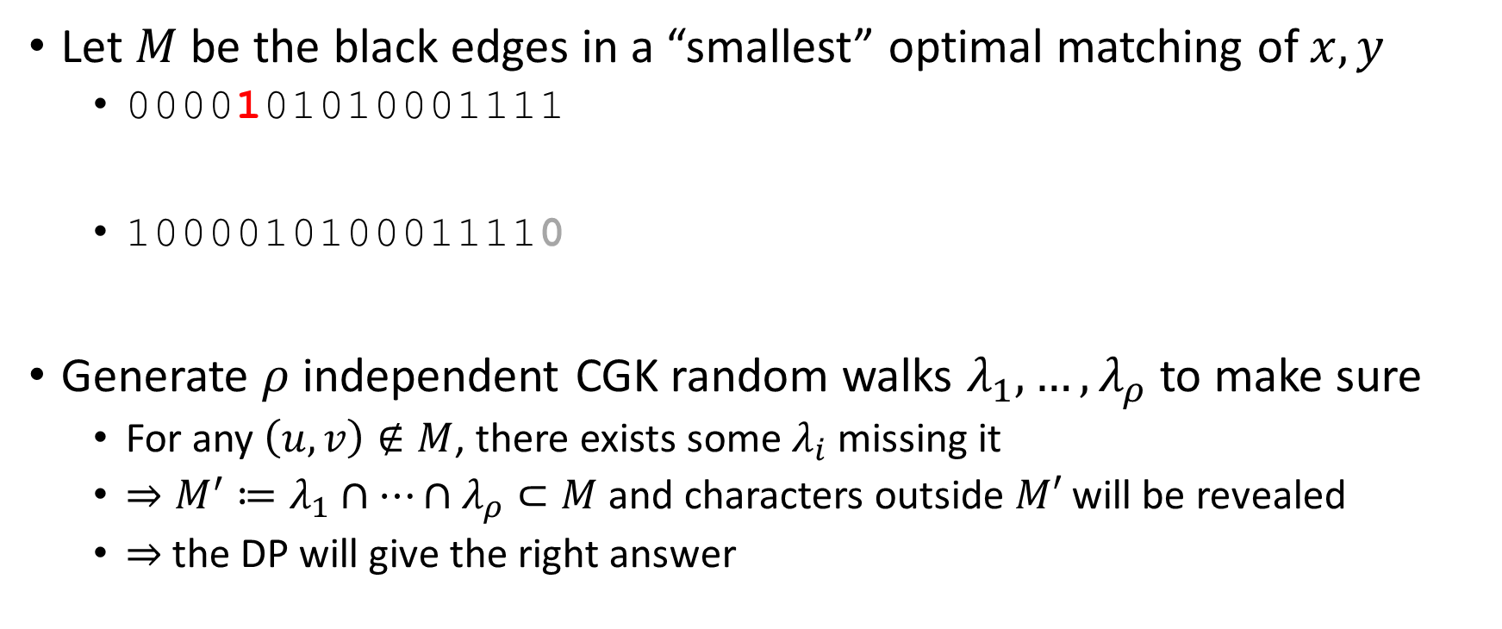
General framework
Let $M$ be the black edges in a “smallest” optimal matching of $x,y$
0000101010001111
1000010100011110
Generate $ρ$ independent CGK random walks $λ_{1},…, λ_{ρ}$ to make sure
For any $\left(u,v\right)∉M$, there exists some $λ_{i}$ missing it
$⇒M^{′}≔λ_{1}∩⋯∩λ_{ρ}⊂M$ and characters outside $M′$ will be revealed
$⇒$ the DP will give the right answer

Slide 16
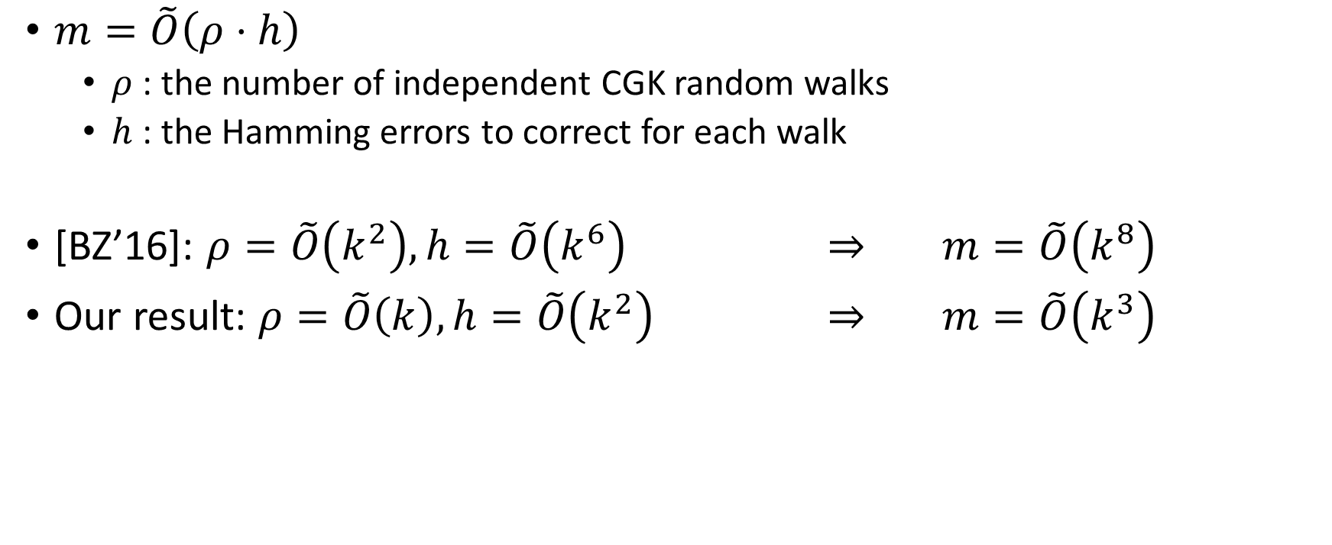

Final sketch length $m$
$m=\tilde{O}\left(ρ⋅h\right)$
$ρ$ : the number of independent CGK random walks
$h$ : the Hamming errors to correct for each walk
[BZ’16]: $ρ=\tilde{O}\left(k^{2}\right), h=\tilde{O}\left(k^{6}\right)$ $⇒$ $m=\tilde{O}\left(k^{8}\right)$
Our result: $ρ=\tilde{O}\left(k\right),h=\tilde{O}\left(k^{2}\right)$ $⇒$ $m=\tilde{O}\left(k^{3}\right)$

Slide 17
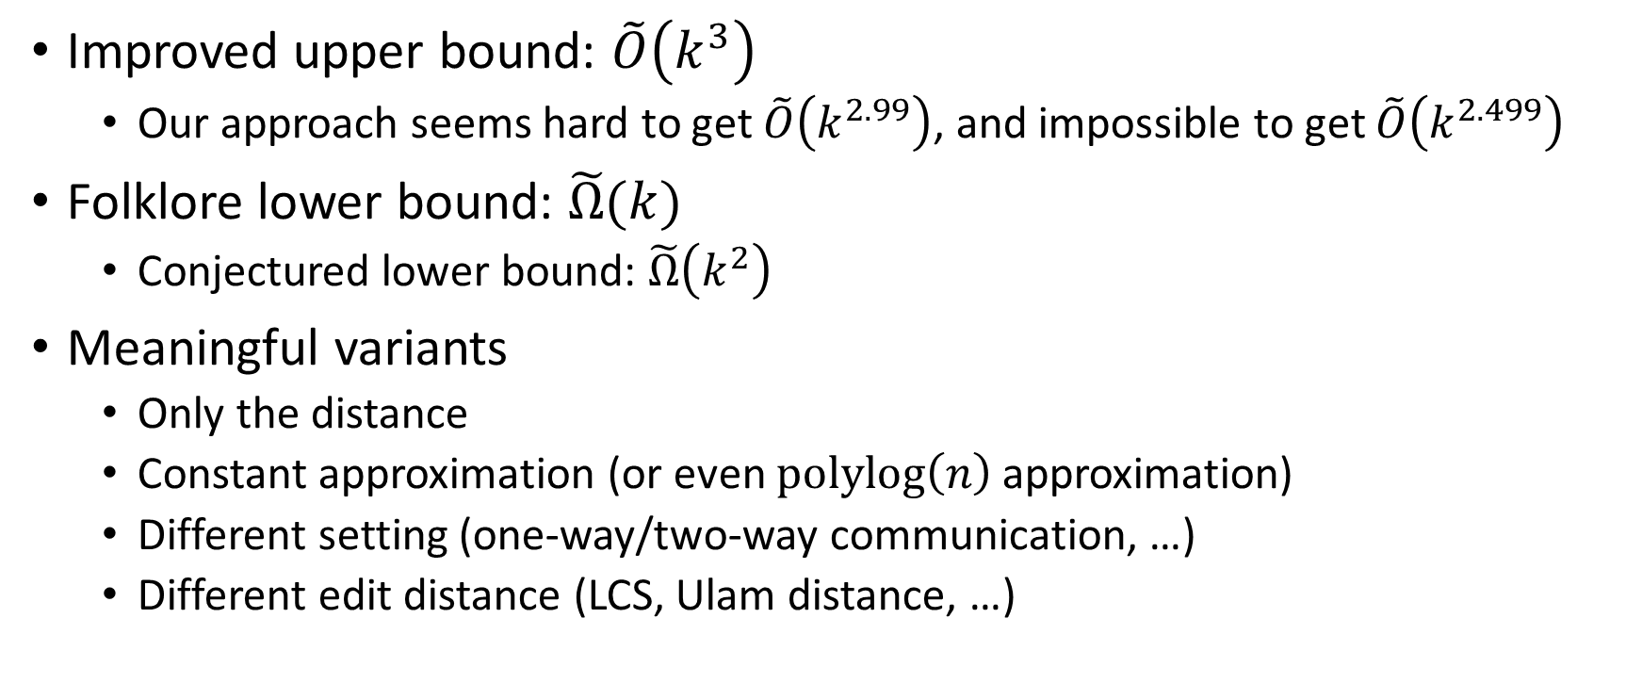
Summary
Improved upper bound: $\tilde{O}\left(k^{3}\right)$
Our approach seems hard to get $\tilde{O}\left(k^{2.99}\right)$, and impossible to get $\tilde{O}\left(k^{2.499}\right)$
Folklore lower bound: $\tilde{Ω}(k)$
Conjectured lower bound: $\tilde{Ω}\left(k^{2}\right)$
Meaningful variants
Only the distance
Constant approximation (or even $polylog\left(n\right)$ approximation)
Different setting (one-way/two-way communication, …)
Different edit distance (LCS, Ulam distance, …)

Slide 18
Thanks!
References
[CGK16] Streaming algorithms for embedding and computing edit distance in the low distance regime, STOC’16
Diptarka Chakraborty, Elazar Goldenberg, Michal Koucky
[BZ16] Edit Distance: Sketching, Streaming, and Document Exchange, FOCS’16
Djamal Belazzougui, Qin Zhang

